Slide 1
Photodetection in KM3NeT
APPEC Technology Forum 2015
Low Light-Level Detection in Astroparticle Physics and in Medical Applications
22+23 April 2015, Munich, Germany
Uli Katz
ECAP / Univ. Erlangen

Slide 2
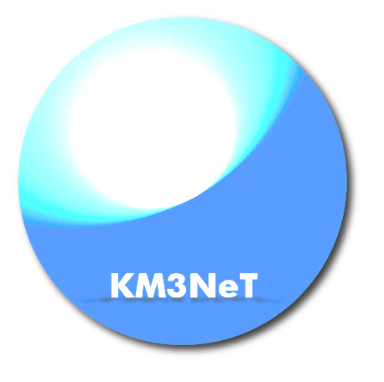
The plan for the next 30 minutes:
The KM3NeT project: Concept and overview
Light detection in KM3NeT
Prototype results
Timelines
Summary

Slide 3
The KM3NeT project:
Concept and overview

Slide 4
How does a neutrino telescope work?
Neutrino interacts in the
(vicinity of the) telescope
Charged secondaries cross the detector volume (water or ice) and stimulate Cherenkov emission
Recorded by a 3D-array of photo-sensors
Neutrino energy range :
few GeV – above PeV
(depends on density of instrumentation)

Slide 5
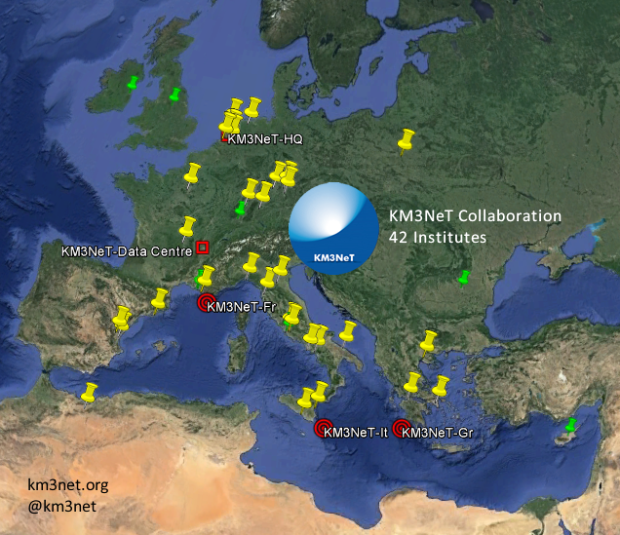
The KM3NeT Collaboration

Slide 6
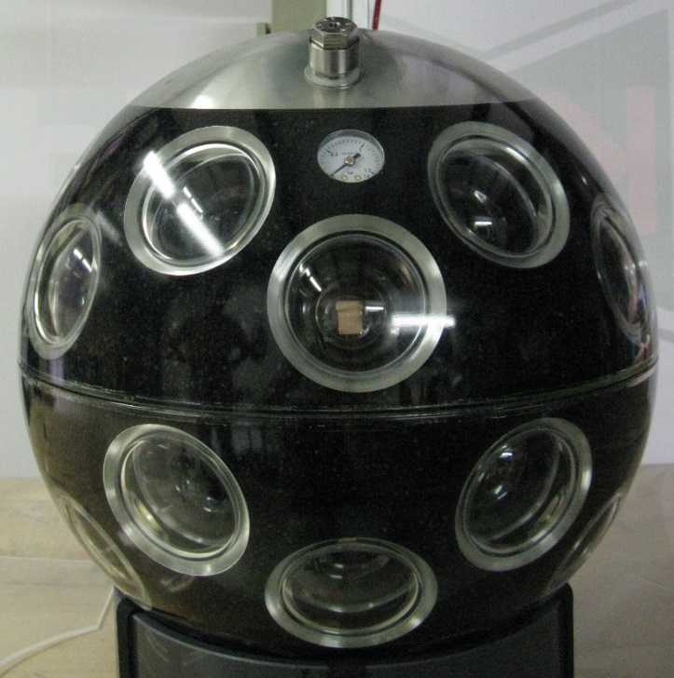
The KM3NeT DOM
31 3-inch PMTs in 17-inch glass sphere (cathode area~ 3x10-inch PMTs)
  19 in lower, 12 in upper hemisphere
  Suspended by plastic structure
31 PMT bases (total ~140 mW) (D)
Front-end electronics (B,C)
Al cooling shield and stem (A)
Single penetrator
Advantages:
  Increased photocathode area
  1-vs-2 photo-electron separation
  → better sensitivity to coincidences
  Directionality
  Cost / photocathode area
A
B
C
C
D
PMT

Slide 7
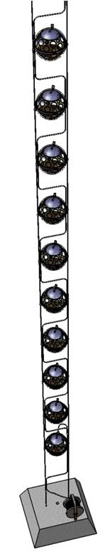
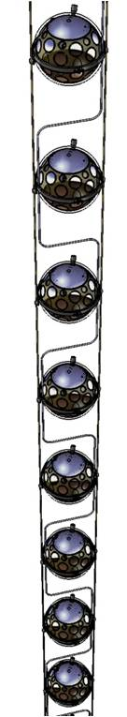
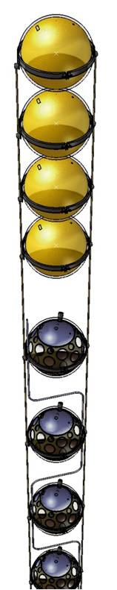
KM3NeT detection units (DUs)
Mooring line:
  Buoy (syntactic foam)
  2 pre-stretched Dyneema© ropes
  (4 mm diameter)
  18 storeys (one DOM each)
Electro-optical backbone (VEOC):
  Flexible hose ~ 6mm diameter
  Oil-filled
  Fibres and copper wires
  At each storey:
  connection to 1 fibre + 2 wires
  Break-out box with fuses at each storey: One single pressure transition

Slide 8
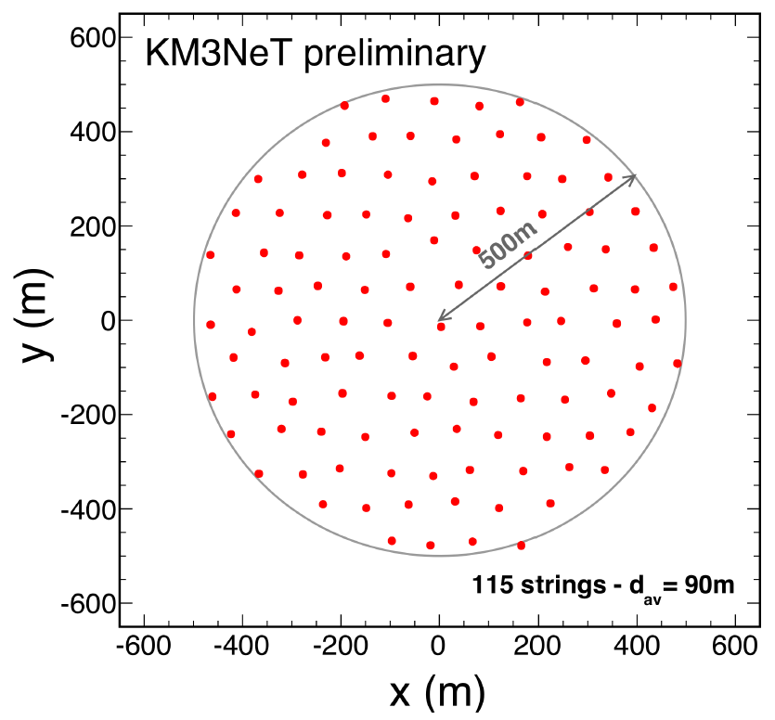
The building block concept
Building block:
  115 detection units
  Segmentation enforced
  by technical reasons
  Large block (neutrino astronomy)
  Sensitivity for muons
  independent of block size
  above ~75 strings
  One block ~ half IceCube
Small block (neutrino oscillations)
      Precision measurement of atmospheric neutrinos
      One block ~ 6 Mtons
  Allows for staged, block-wise, multi-site installation
DU distance adjusted to scientific objective:
90-120 m for neutrino astronomy /
20 m for oscillation research

Slide 9
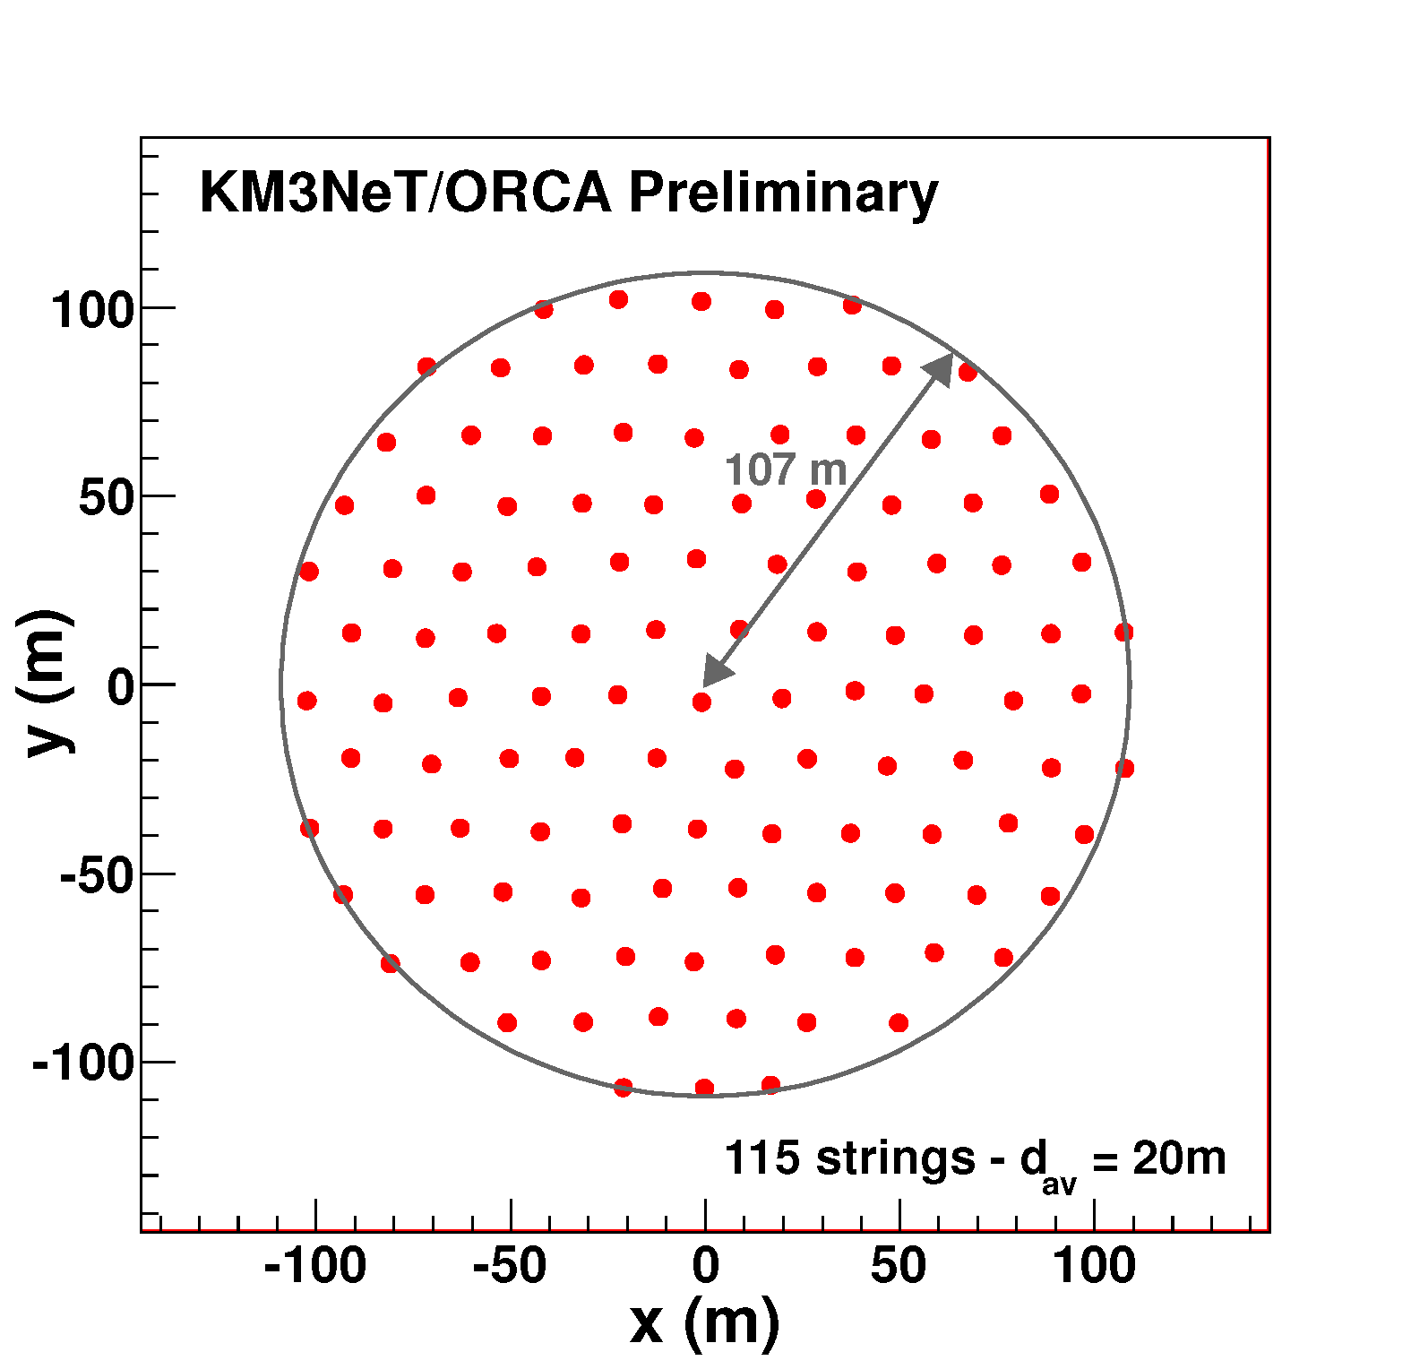
ARCA and ORCA
Vertical OM distance = 36 m
ARCA =
Astroparticle
Research with
Cosmics in the
Abyss
+
ORCA =
Oscillation
Research with
Cosmics in the
Abyss
Vertical OM distance = 6 – 12 m

Slide 10
KM3NeT development
Phase | Blocks/ strings | Primary deliverables / site(s) | PMTs needed
1 | 0.2/31 | Proof of feasibility and first science results; KM3NeT-Fr + KM3NeT-It sites | 18.000
2.0 | 2/230 | Measurement of neutrino signal reported by IceCube; All-flavor neutrino astronomy; KM3NeT-It site | +175.000
 | 1/115 | Neutrino mass hierarchy; KM3NeT-Fr site
3 | 6+1/805 | Neutrino astronomy including Galactic sources; Multiple sites | +260.000

Slide 11
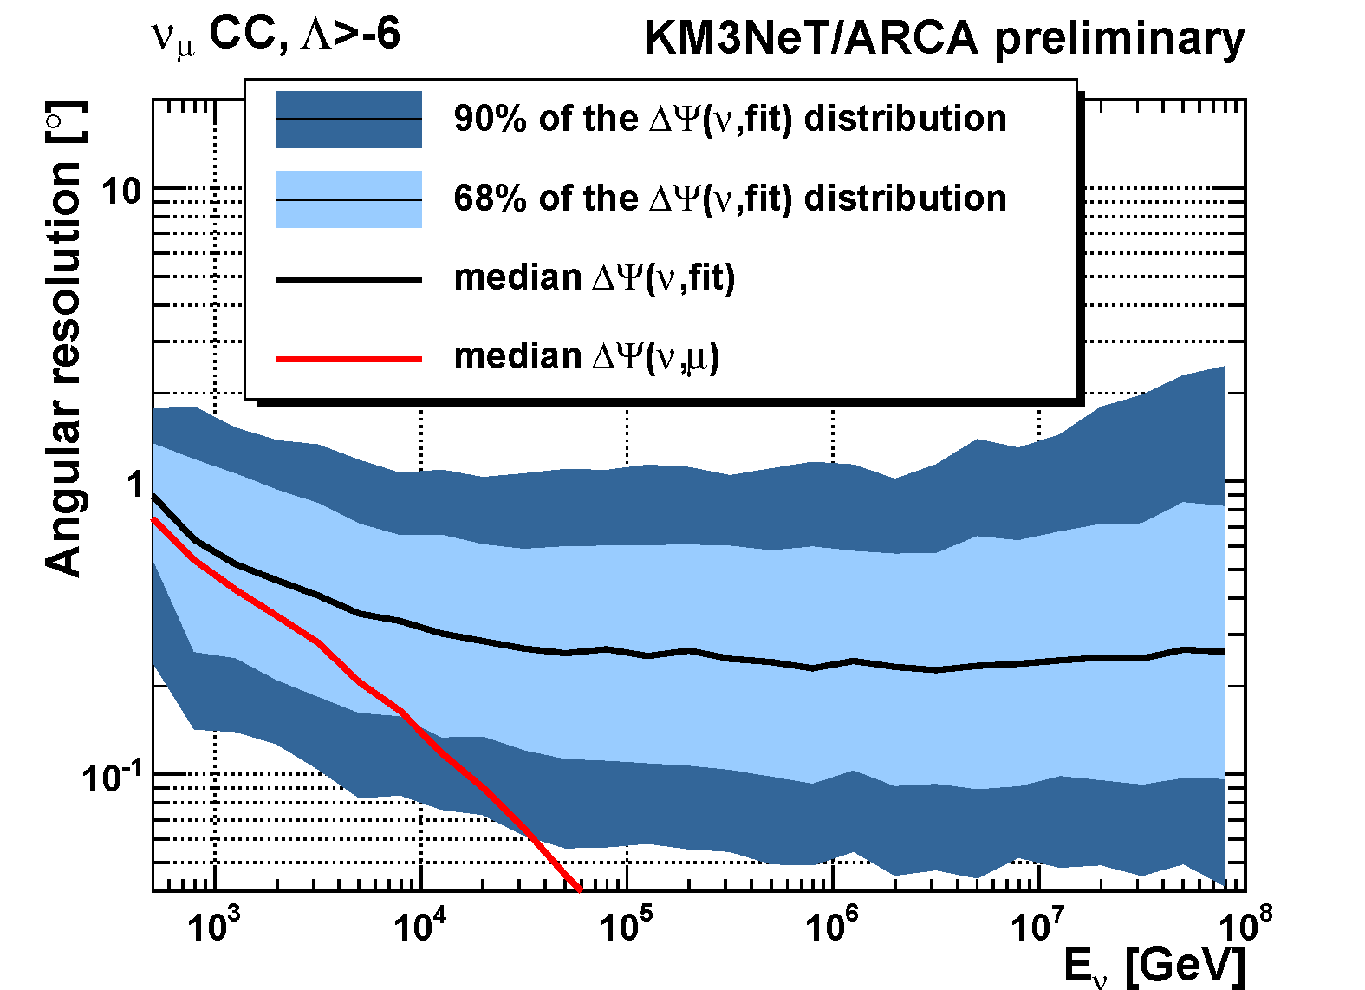
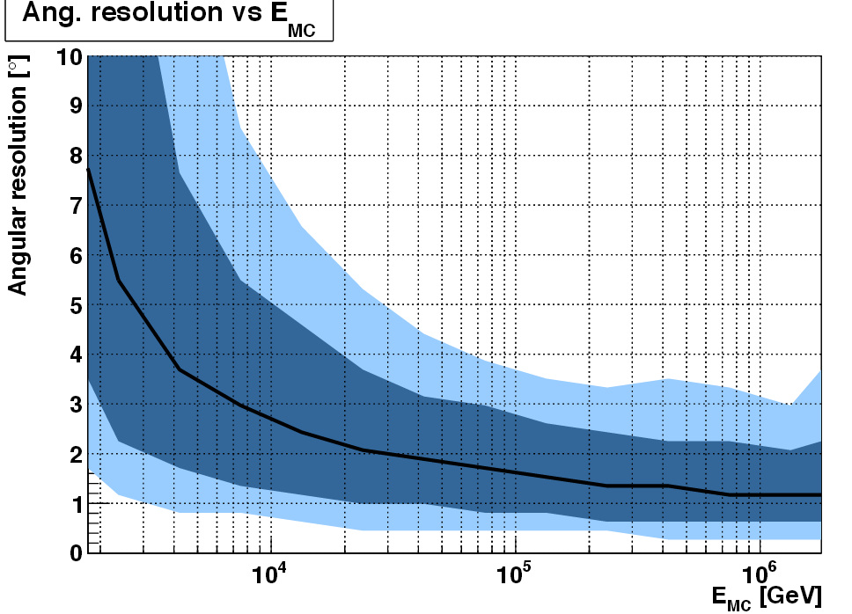
KM3NeT resolutions
Track-like events: Cascades:
ν_{e} CC events
with containment cut
1°
2°
Muon energy: d(log10 E)=0.25-0.3 at E > 10 TeV
Cascade energy: 5-10% at E > some 10 TeV
All-flavour neutrino astronomy in reach

Slide 12
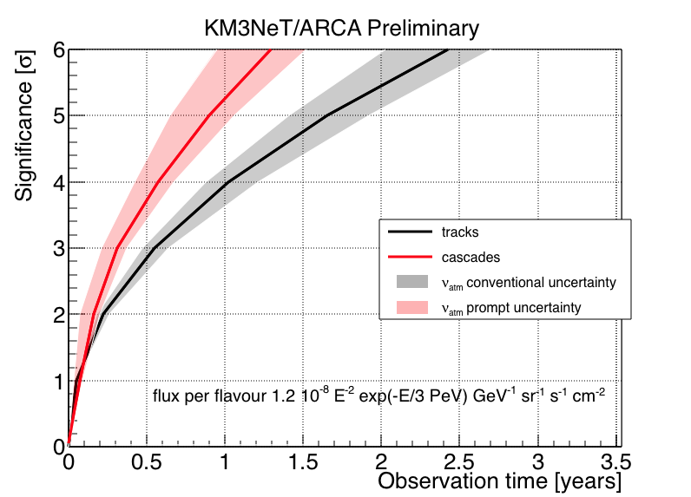
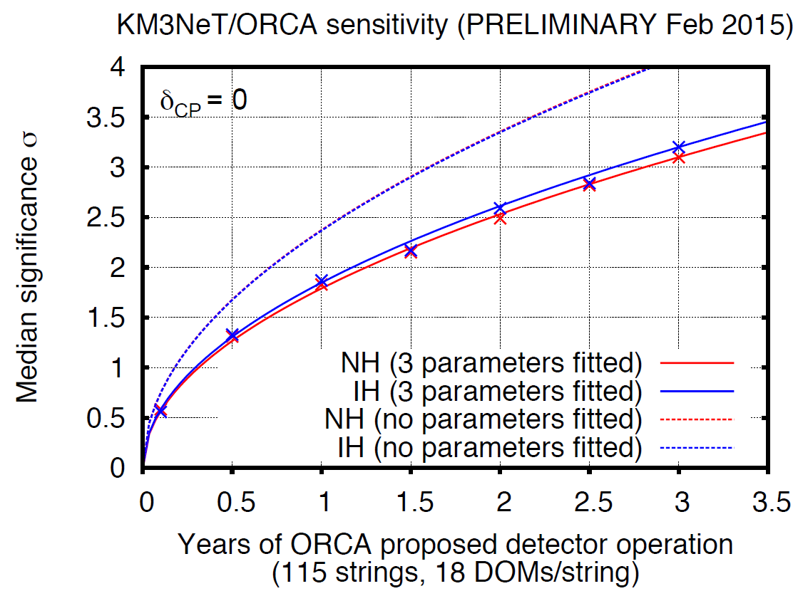
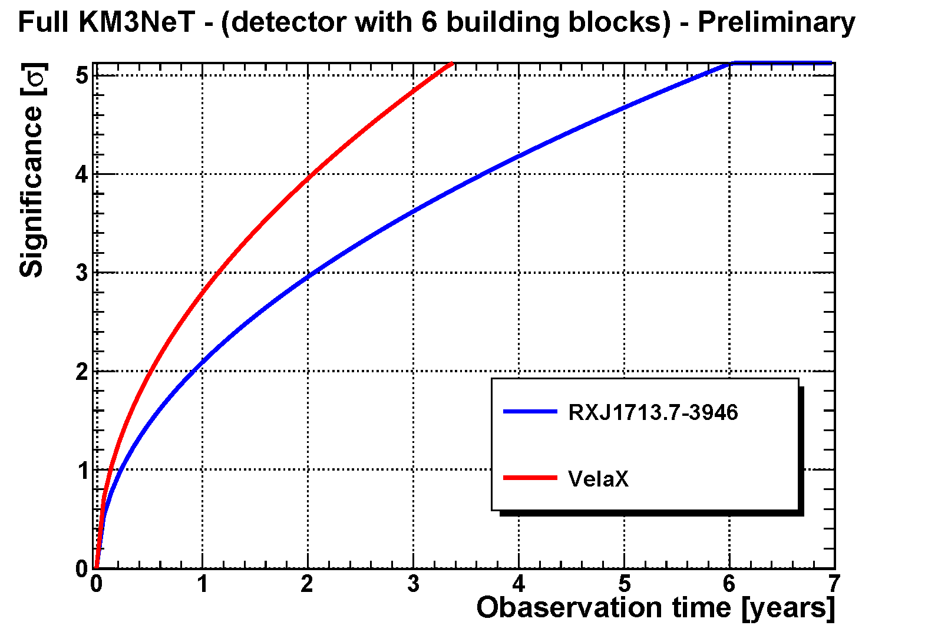
KM3NeT science objectives
All-flavour neutrino astronomy
Precision measurements in neutrino physics
Nodes for earth and sea science research

Slide 13
Light detection in KM3NeT

Slide 14
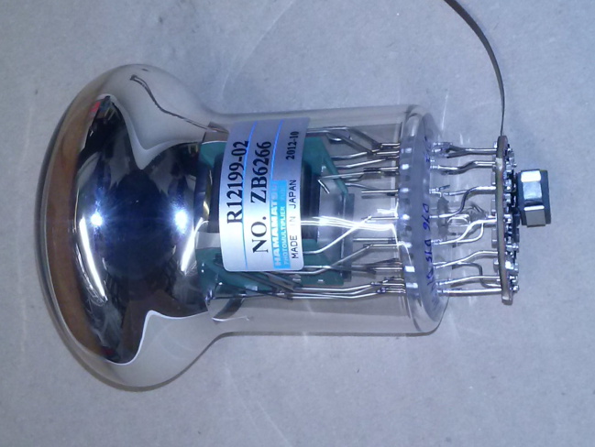
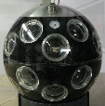
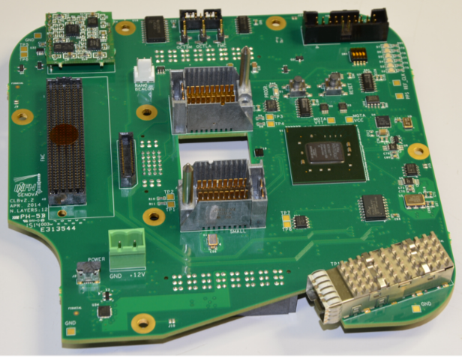
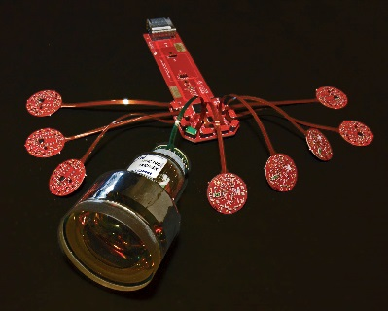
KM3NeT readout
Power board
All data
to shore
(optical
Fibres)
31 PMTs + bases
2 octopus boards
Online filter
on shore
Central Logic Board
(CLB)
HV for PMTs
Discrimination
w.r.t. predefined threshold
Signal collection
FPGA for TDC (time & time over threshold), time stamping (1 ns precision);
Interface for time synchronisation:
Control of calibration devices; Communication;

Slide 15
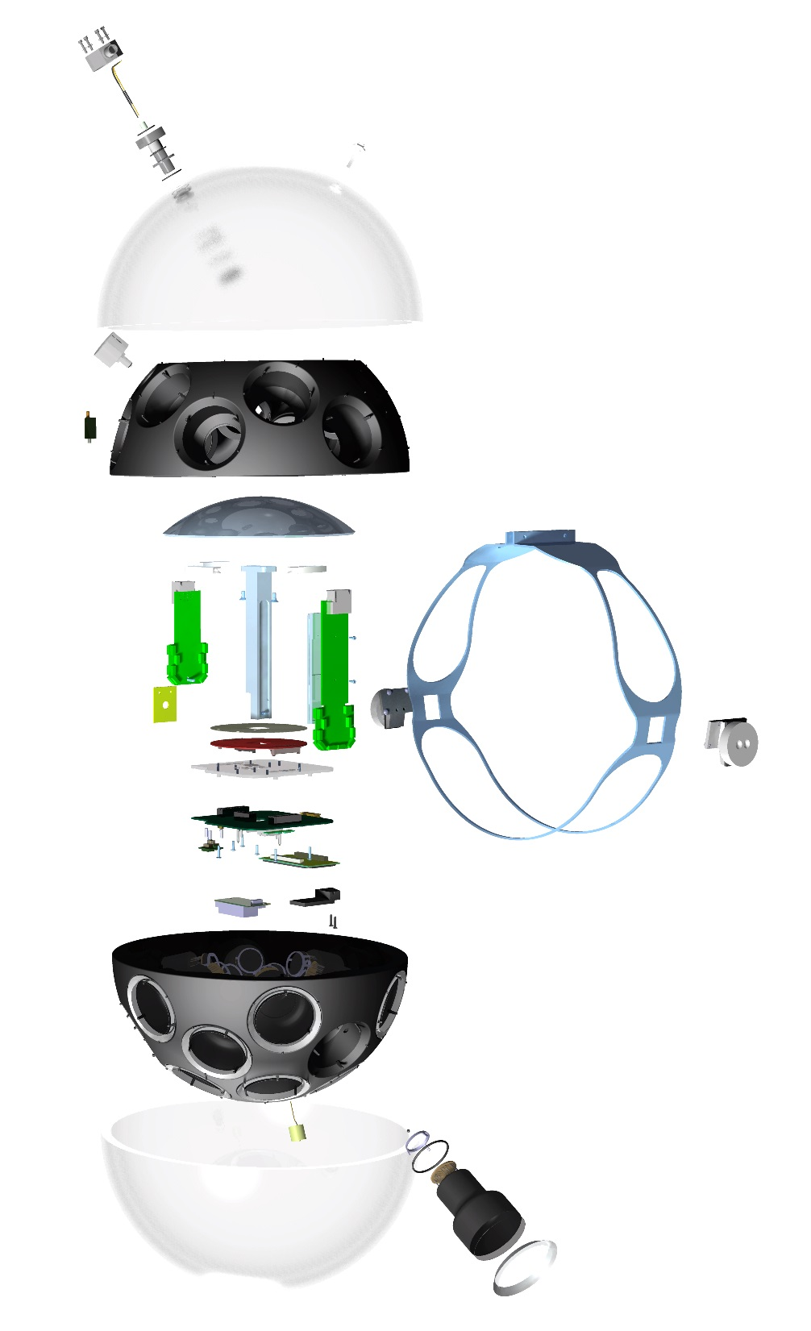
Implementation in DOM
Reflective rings around PMTs
(+27% light detection, see
JINST 8 (2013) T03006)
PMTs supported by plastic structure
produced by 3D-printing
Calibration: Acoustic sensor and
compass + tiltmeter
Electronics components attached
to cooling structure
One single penetrator for
connection to vertical cable

Slide 16
PMT specifications
Parameter | Requirement
Photocathode diameter | > 72 mm
Nominal Voltage for Gain 3x10⁶ | 900 – 1300 V
Gain slope = log₁₀(gain)/log₁₀(HV) | 6.5 – 8.0
QE at 404 nm | > 23 %
QE at 470 nm | > 18 %
TTS (FWHM) | < 5 ns
Dark count rate (0.3 p.e. threshold) | < 2 kHz
Pre-pulses | < 1 %
Delayed pulses | < 3.5 %
Early afterpulses | < 2 %
Late afterpulses | < 10 %

Slide 17
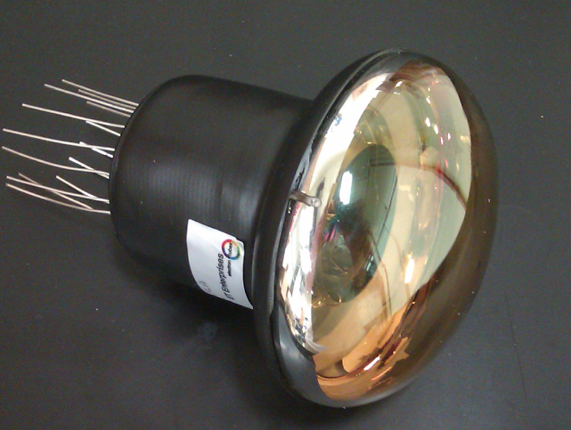
PMTs available
+MELZ …
ETEL D792
Hamamatsu R12199
HZC XP53B20
☺ ☺ 😐
First prototype not yet
compliant with specifications
(gain, dark rate, afterpulses, …),
further development under way
Fulfil specifications; orders placed / expected
Note: In all cases price/photocathode area < 10-inch tubes (MELZ?)

Slide 18
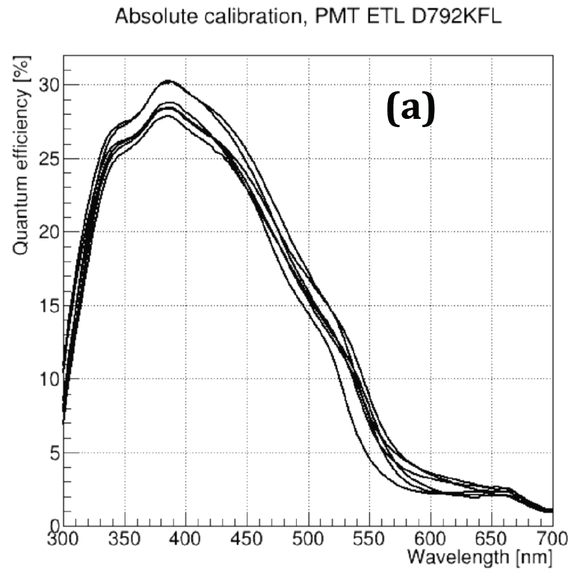
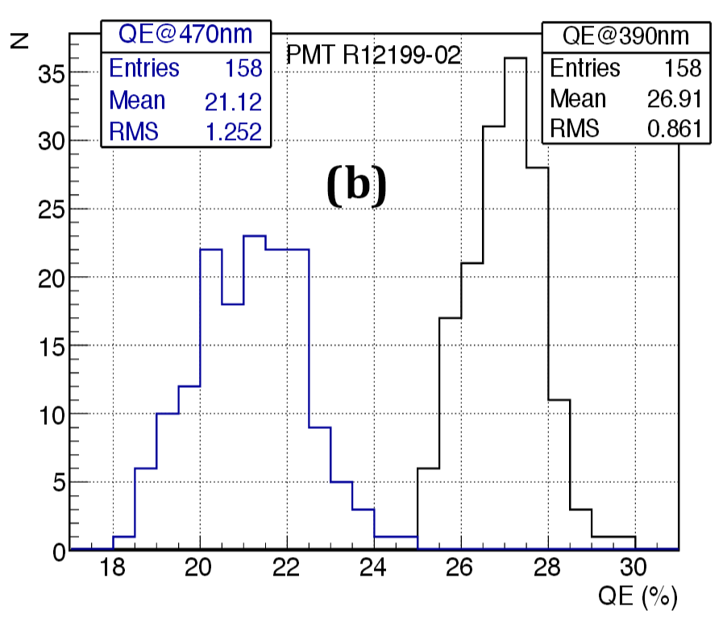
Some results of PMT measurements: QE …
Hamamatsu
Note: These are “normal”, i.e. not super- or hyper-bialkali PMTs

Slide 19
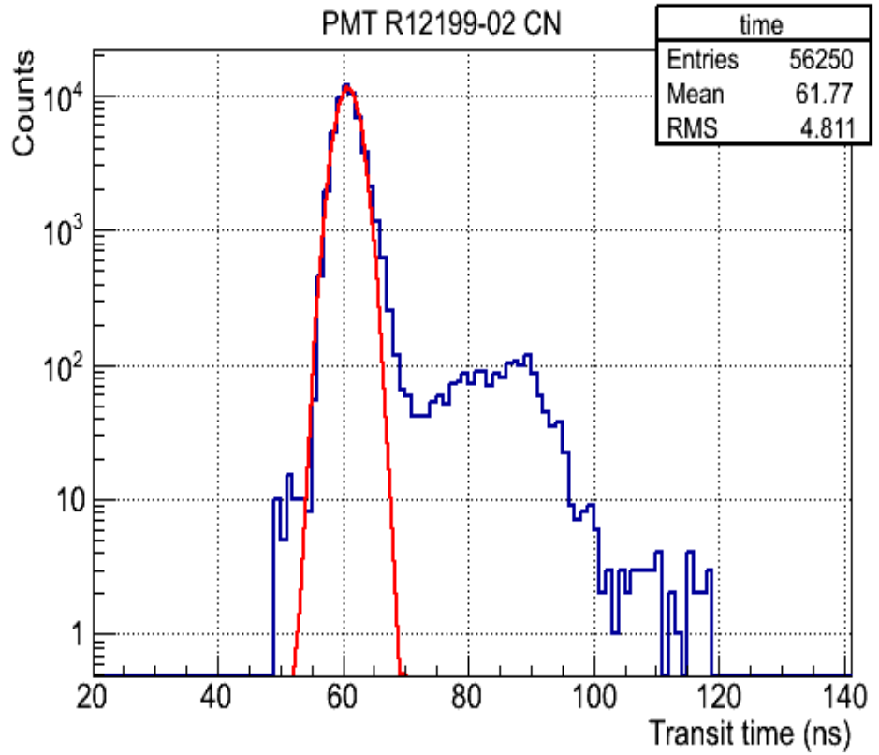
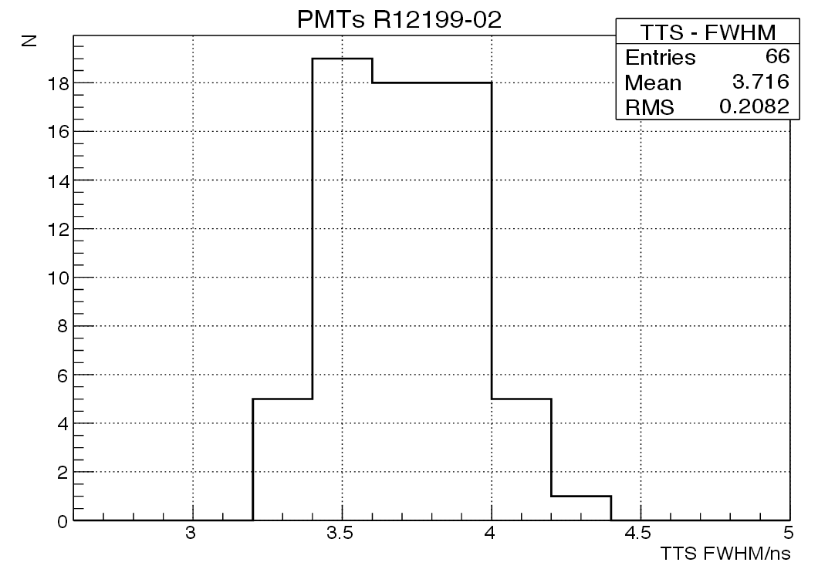
… and TTS
Hamamatsu
Hamamatsu
All measurements for ETEL & Hamamatsu within specifications

Slide 20
Prototype results

Slide 21
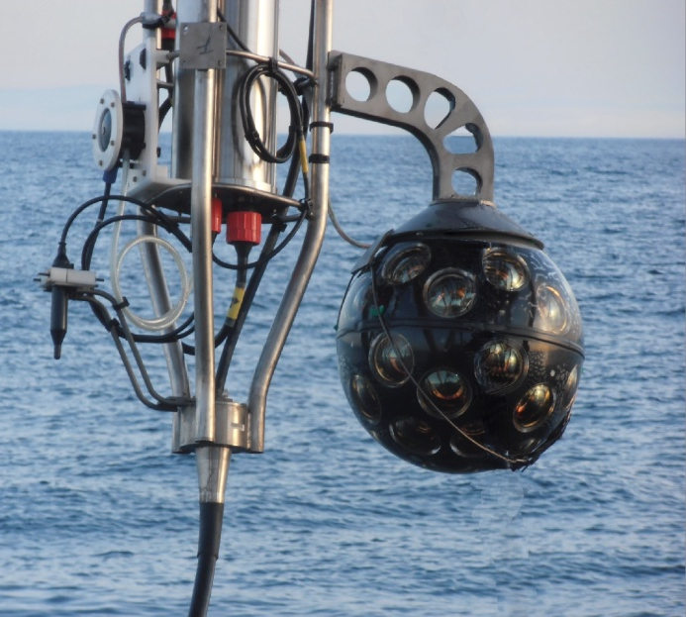
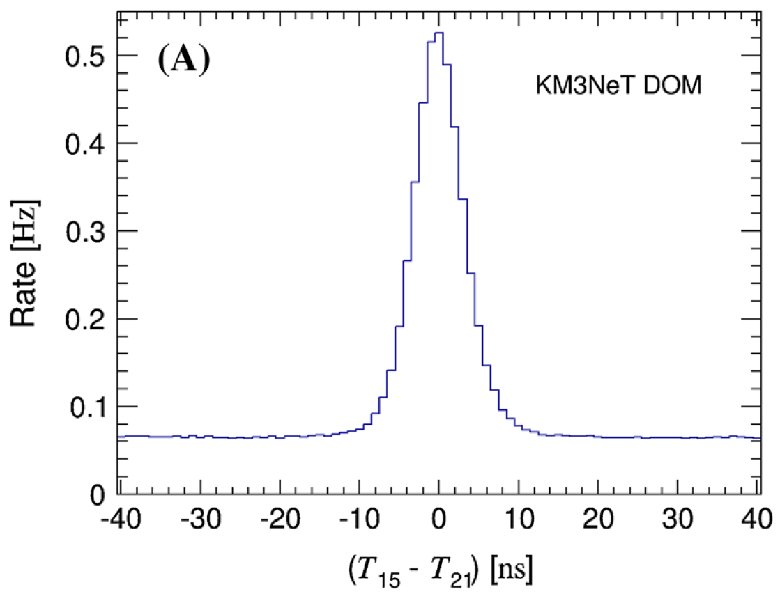

DOM prototype (PPM-DOM)
Deployed at
ANTARES in
April 2013
Coincidence rate on 2 adjacent PMTs
(33°angular separation)
K⁴⁰ coincidence rate
→ PMT efficiencies
^{γ}
^{γ}
Peak position
→ time offsets
e⁻ (β decay)
Up to 150
Cherenkov
photons
per decay
⁴⁰K
⁴⁰Ca
Eur.Phys.J. C74 (2014) 3056
Concentration of ⁴⁰K is stable
(coincidence rate ~5 Hz on adjacent PMTs)

Slide 22
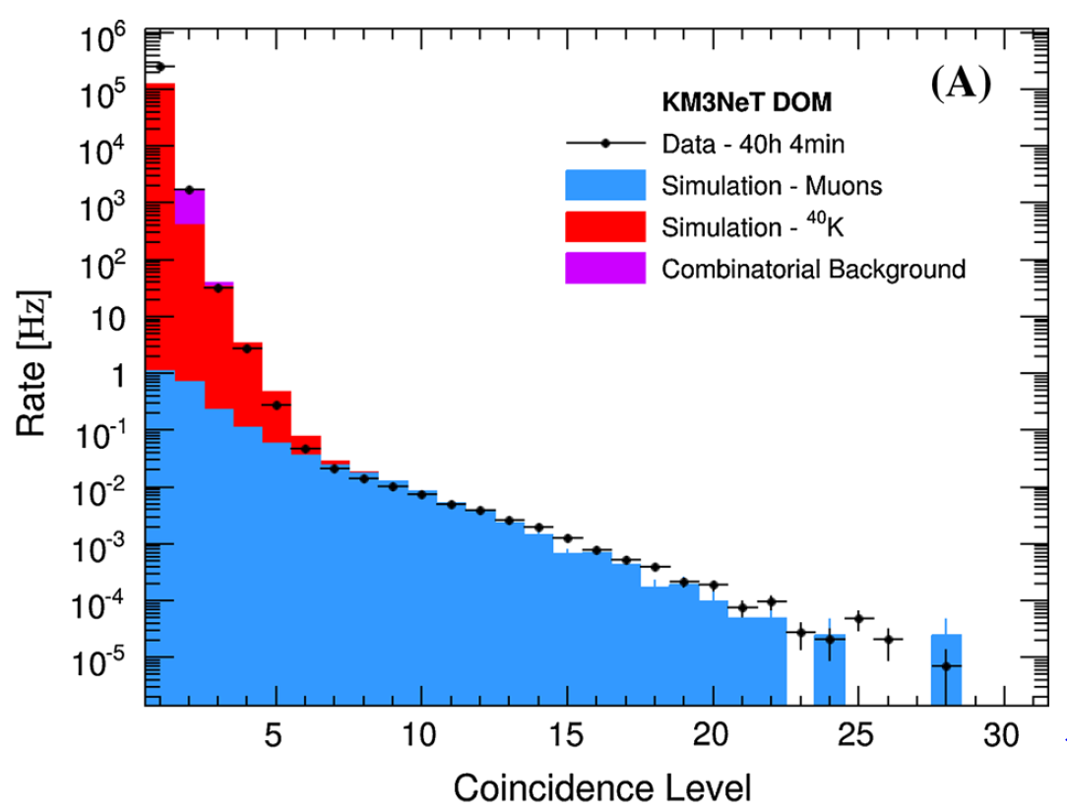
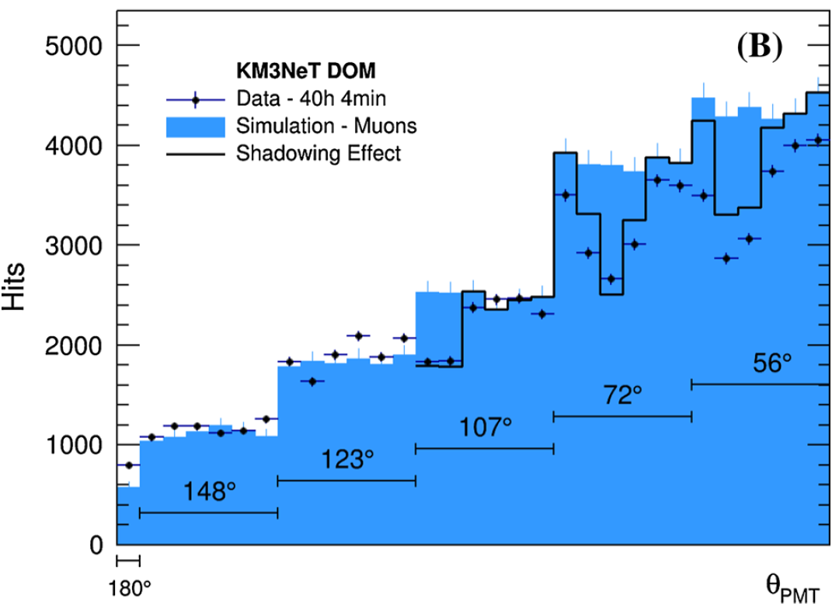
PPM-DOM: Atmospheric Muons
Eur.Phys.J. C74 (2014) 3056
Number of coincident hits in a DOM
Zenith angle of hit PMTs in events with more than 7 coincident hits
>5 coincidences within 20ns ⇒
reduced K40 contribution,
dominated by atmospheric muons
More upper PMTs in multi-hit events ⇒
directional information
from single storey

Slide 23
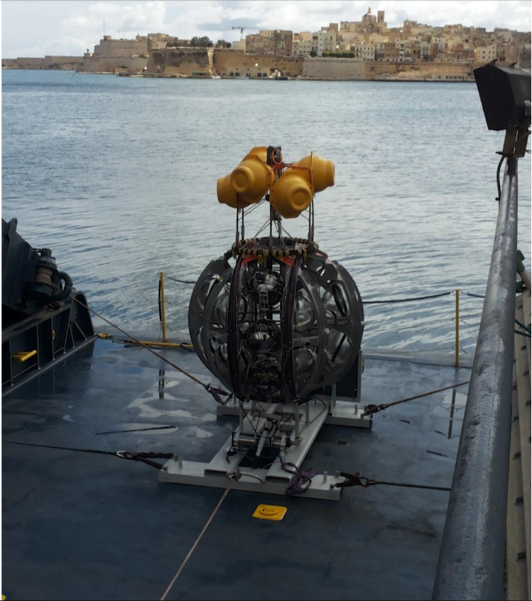
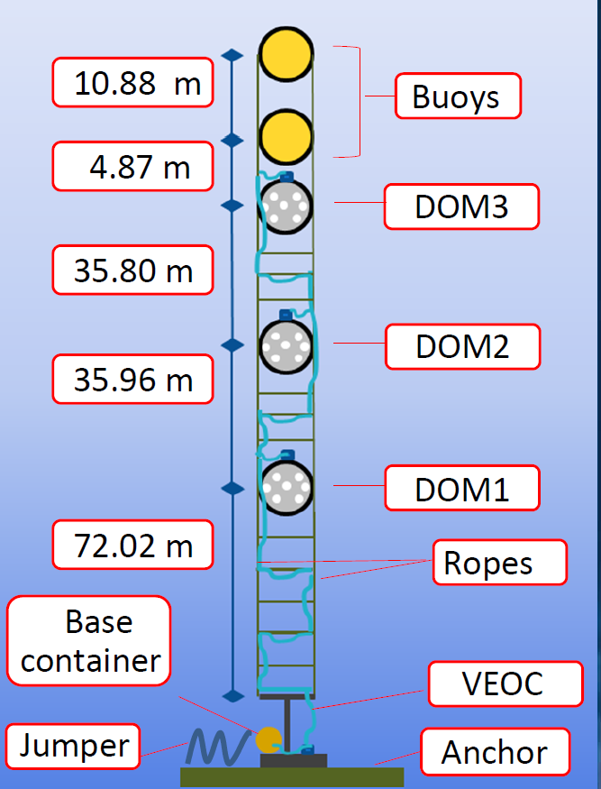
DU mini-prototype (PPM-DU): 3 DOMs
Deployed at
KM3NeT-It
in May 2014

Slide 24
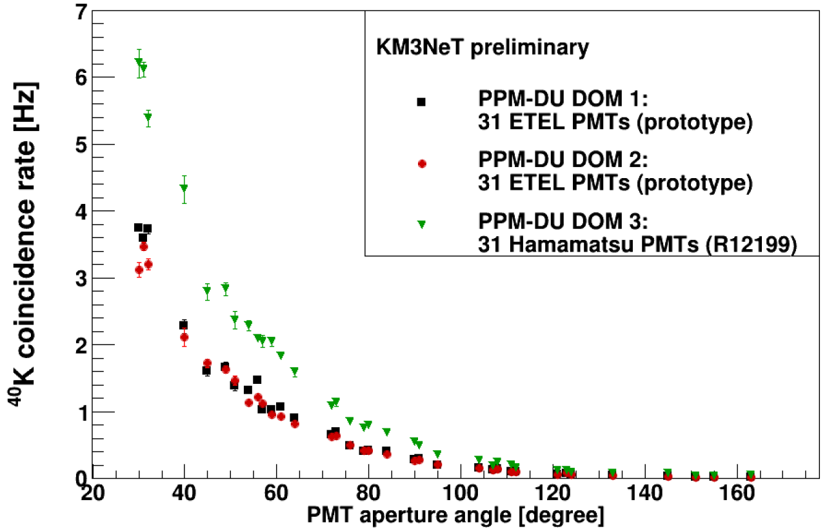
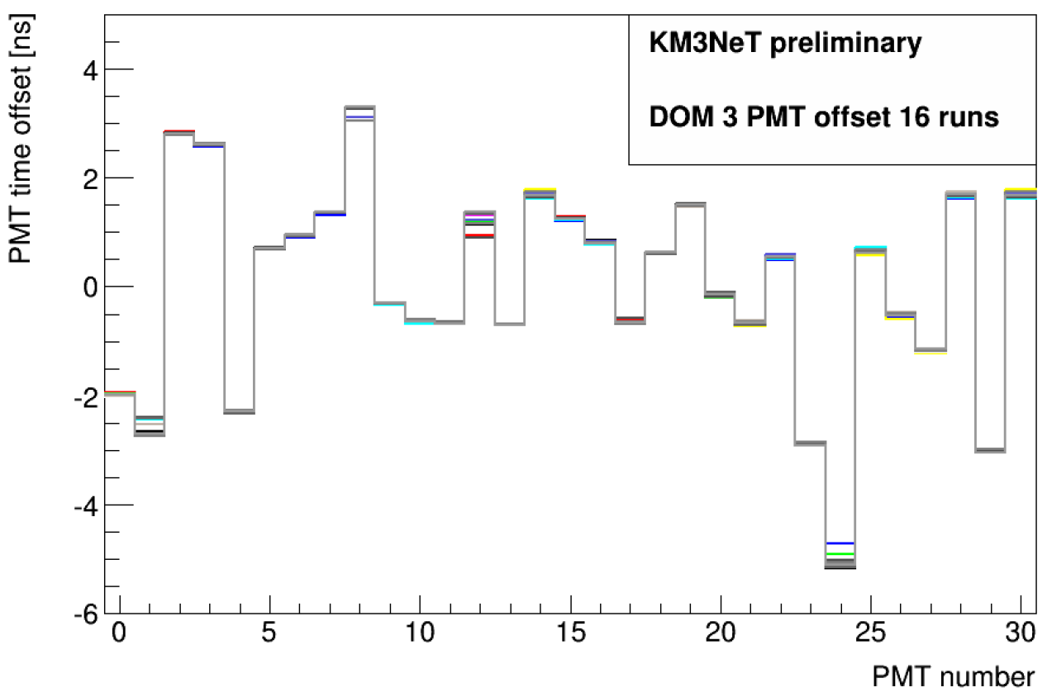
PPM-DU: Inter-DOM timing
K40 coincidence rate as a
function of the angle between PMTs.
Note: Different PMT types!
Relative timing calibration of
31 PMTs in DOM using coincidences.
Note: Extremely stable over many runs

Slide 25
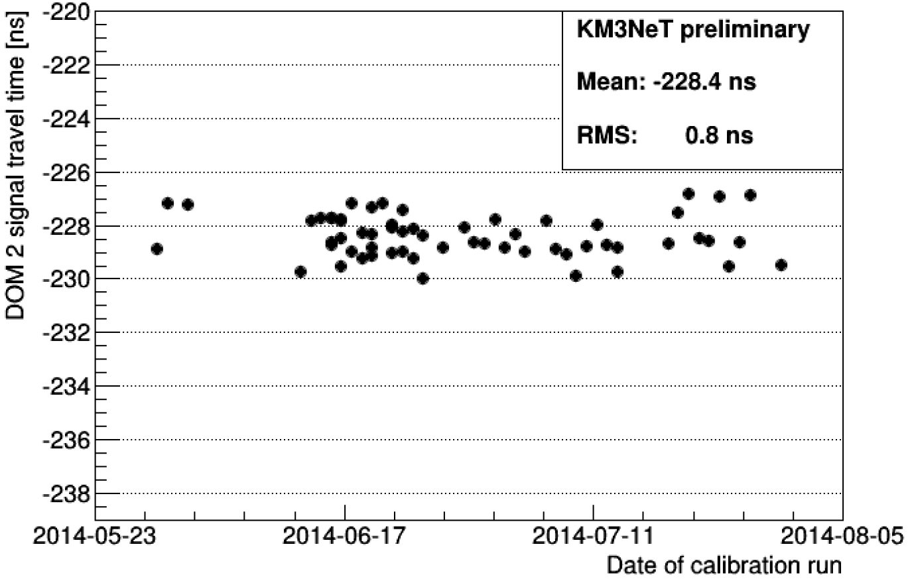
PPM-DU: Intra-DOM timing
Calibration with
pulsed LED
Time difference –
light travel time =
Signal travel time
Result very stable
over several months,
RMS of jitter < 1 ns

Slide 26
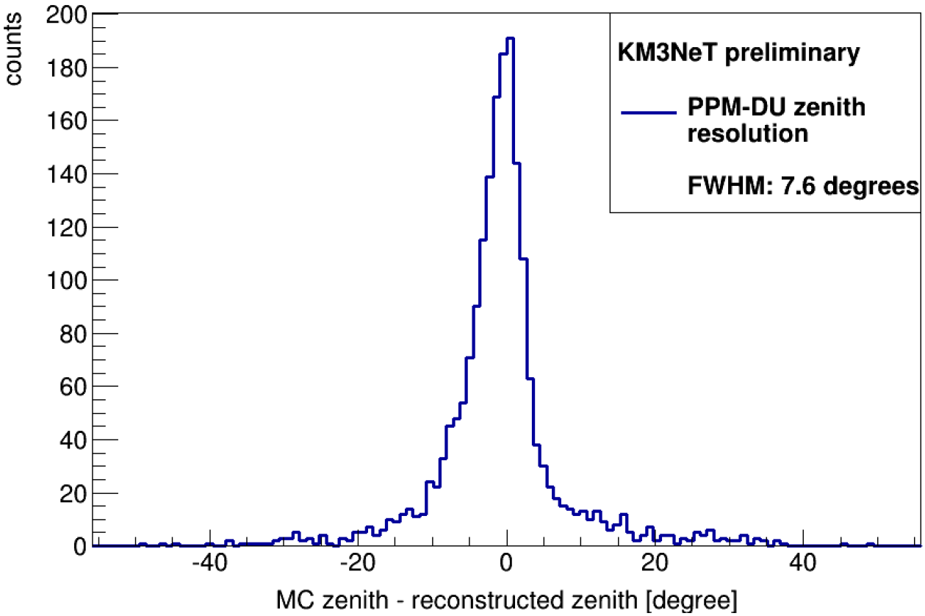
PPM-DU: Muon reconstruction
Reconstruct
muon trajectory
from hits on
3 DOMs
Ambiguities can
be reduced by cuts
on time differences
7° FWHM resolution
achieved

Slide 27
Timelines

Slide 28
KM3NeT time lines and funding
Phase | Invest/M€ | Time lines | Funding
1 | 31 | 2014-16: Construction (24 ARCA- and 6 ORCA-DUs) | secured
2.0 | +55 | 2015: ESFRI proposal (decision 2016) 2016-20: Construction 2022: Physics results | applications pending
 | +40
3 | +100-120 | After 2020 | to be defined

Slide 29
Summary

Slide 30
Summary and outlook
KM3NeT is a future multi-site research
infrastructure in the Mediterranean Sea
Priority science goals:
    All-flavour neutrino astronomy
    Measurement of the neutrino mass hierarchy
Light detection using multiple 3-inch PMTs
per optical module
    Concept technically proven
    Prototypes and simulations show high potential
  KM3NeT construction has started (Phase-1),
  next phase (ARCA & ORCA) to follow in 2016-20
Stay tuned!

